Slide 1

Ramrao Adik Institute of Technology
Department of Computer Engineering
Winter Internship project
On
“E-Commerce Product Catalog
(Tsuki.market)"
By
Name of Students: Deeptanshu Lal Shaunak Kundu
Roll No.: 22CE1285
Roll No.: 22CE1161
Guided by
Saguna Ingle

Slide 2


Outline
Introduction
Literature Survey of the existing systems
Limitations of the existing systems
Problem statement
System Design
Technologies and methodologies
Conclusion
References

Slide 3
Problem statement
The e-commerce catalog struggles with user experience, data accuracy, scalability, integration, personalization, security, and differentiation, impacting customer engagement, trust, and business growth

Slide 4
Introduction
Motivation: The realm of fashion is as vast and diverse as the individuals who wear it. Our website ‘Tsuki’ tell a visual story, showcasing various type of clothes that will suit your taste.
Objectives: The objective of our website is multifaceted, aiming to provide a comprehensive, engaging, and user-friendly platform that facilitates online shopping.

Slide 5
Literature Survey of the existing systems
Magento, Shopify, WooCommerce these are among the leading e commerce platforms that offer robust catalog management features.
Researchers have explored their functionalities, customization capabilities, scalability, and performance.
Researchers have explored strategies for personalized content delivery, product recommendations, and targeted marketing based on user-behavior, preferences, and historical data

Slide 6
Literature Survey of the existing systems
Studies have explored the impact of visual elements, product images, videos, and interactive features on user engagement, conversion rates, and overall customer satisfaction.
Literature has examined the role of machine learning algorithms, data analytics, and AI-driven recommendation systems in enhancing e commerce catalogs.
The e-commerce catalog serves as a digital storefront, showcasing products and facilitating online purchases for consumers worldwide

Slide 7
Limitations of existing systems
Scalability Issues: Some e-commerce platforms may face scalability constraints, particularly during peak traffic periods or rapid business growth. This can lead to performance slow page load times, and potential system crashes, affecting user experience and revenue generation.
Customization Limitations: While many e-commerce platforms offer customizable templates and themes, they may have limitations in terms of design flexibility, functionality customization. This can restrict brands from achieving a unique look, feel, and user experience tailored to their specific needs and brand identity.

Slide 8
Limitations of existing systems
Performance & Speed: E-commerce platforms with inefficient codebase, inadequate hosting infrastructure, or suboptimal caching mechanisms may experience performance issues, slow page load times.

Slide 9
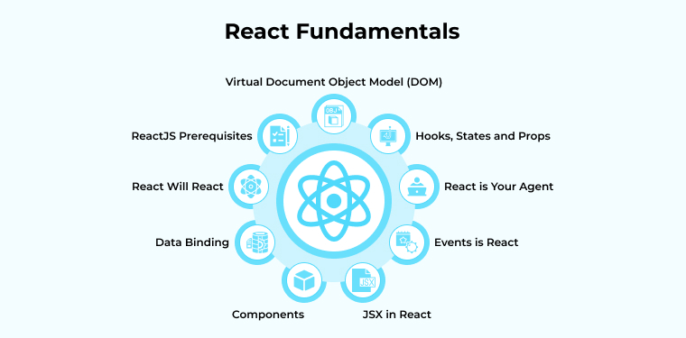

System Design
Designing a system for an e-commerce catalog involves multiple components, considerations, and architectural decisions to ensure scalability, performance, security, usability, and functionality. The main component for our website is React JS.

Slide 10
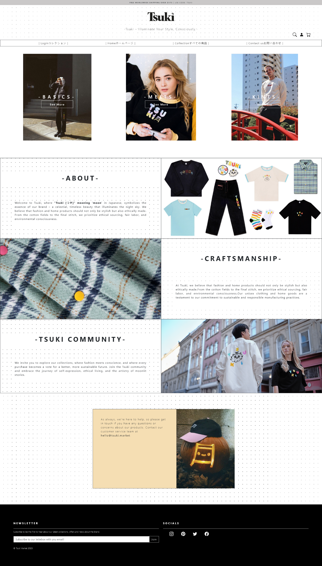
Page Design

Slide 11

Page Design

Slide 12
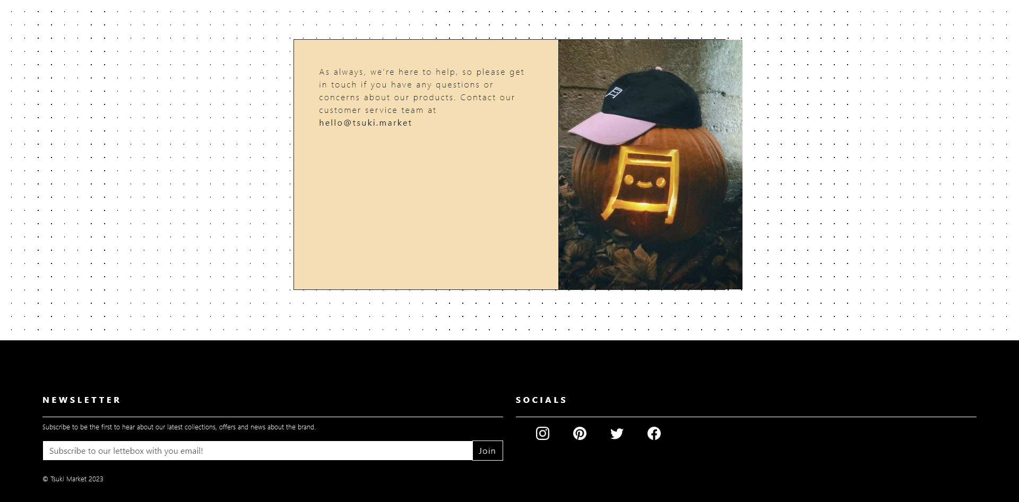
Page Design

Slide 13
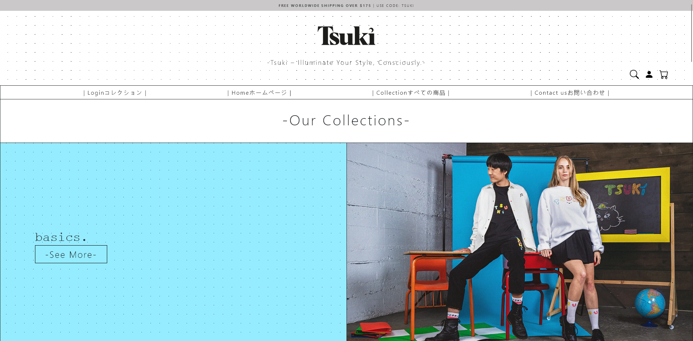
Page Design

Slide 14
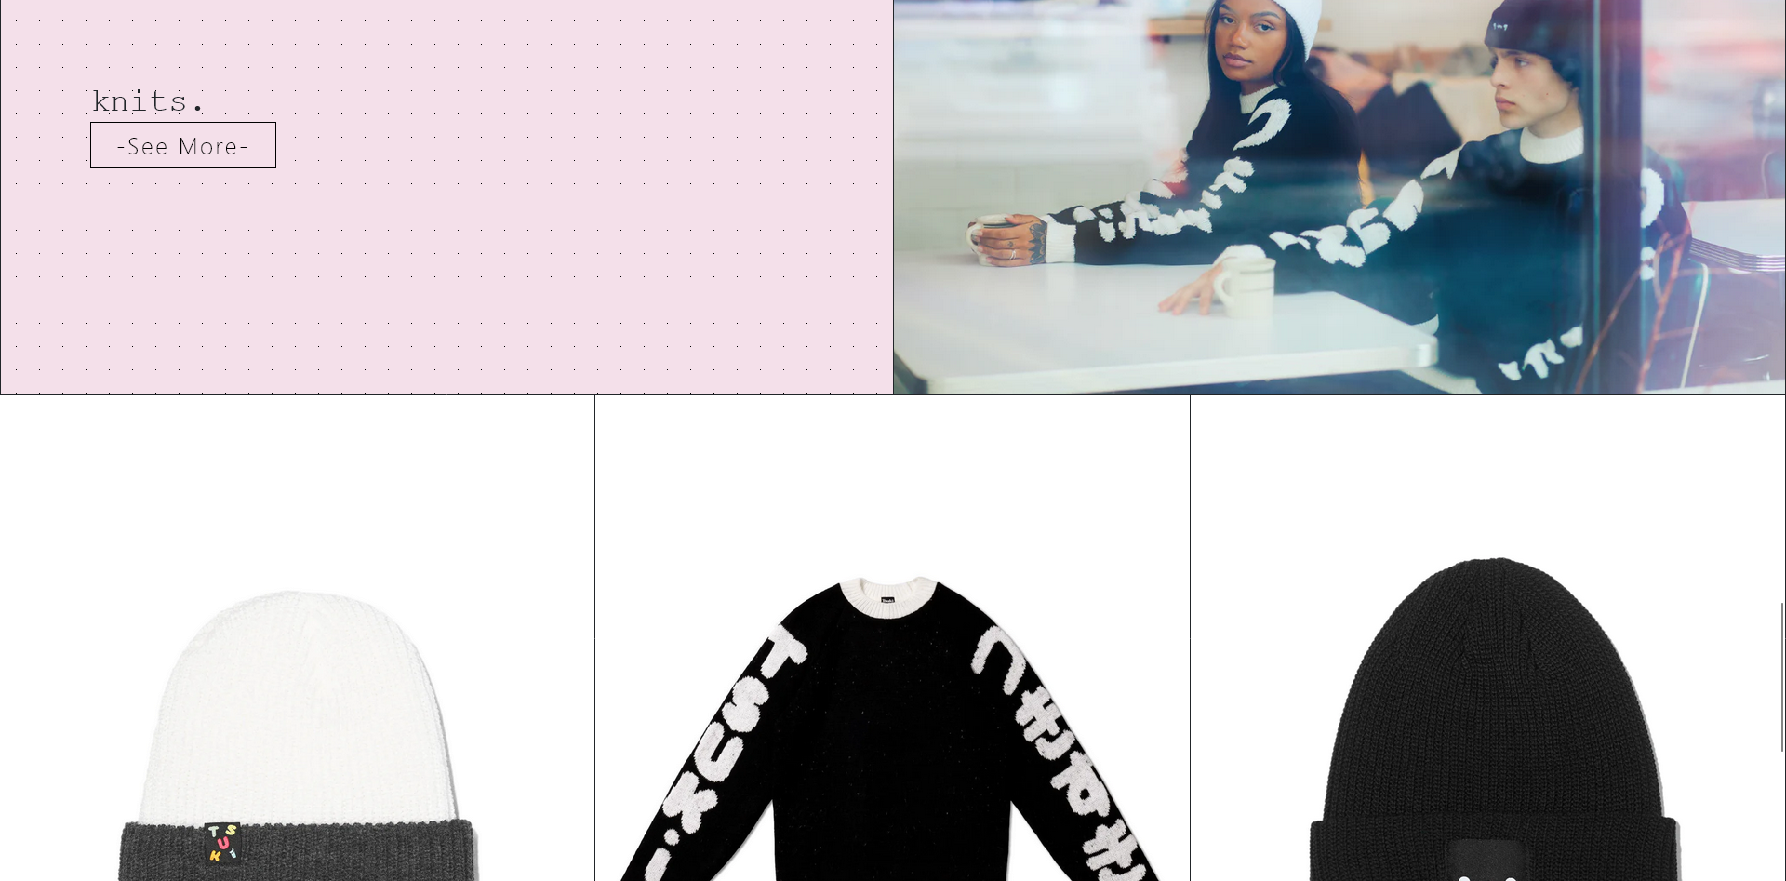
Page Design

Slide 15
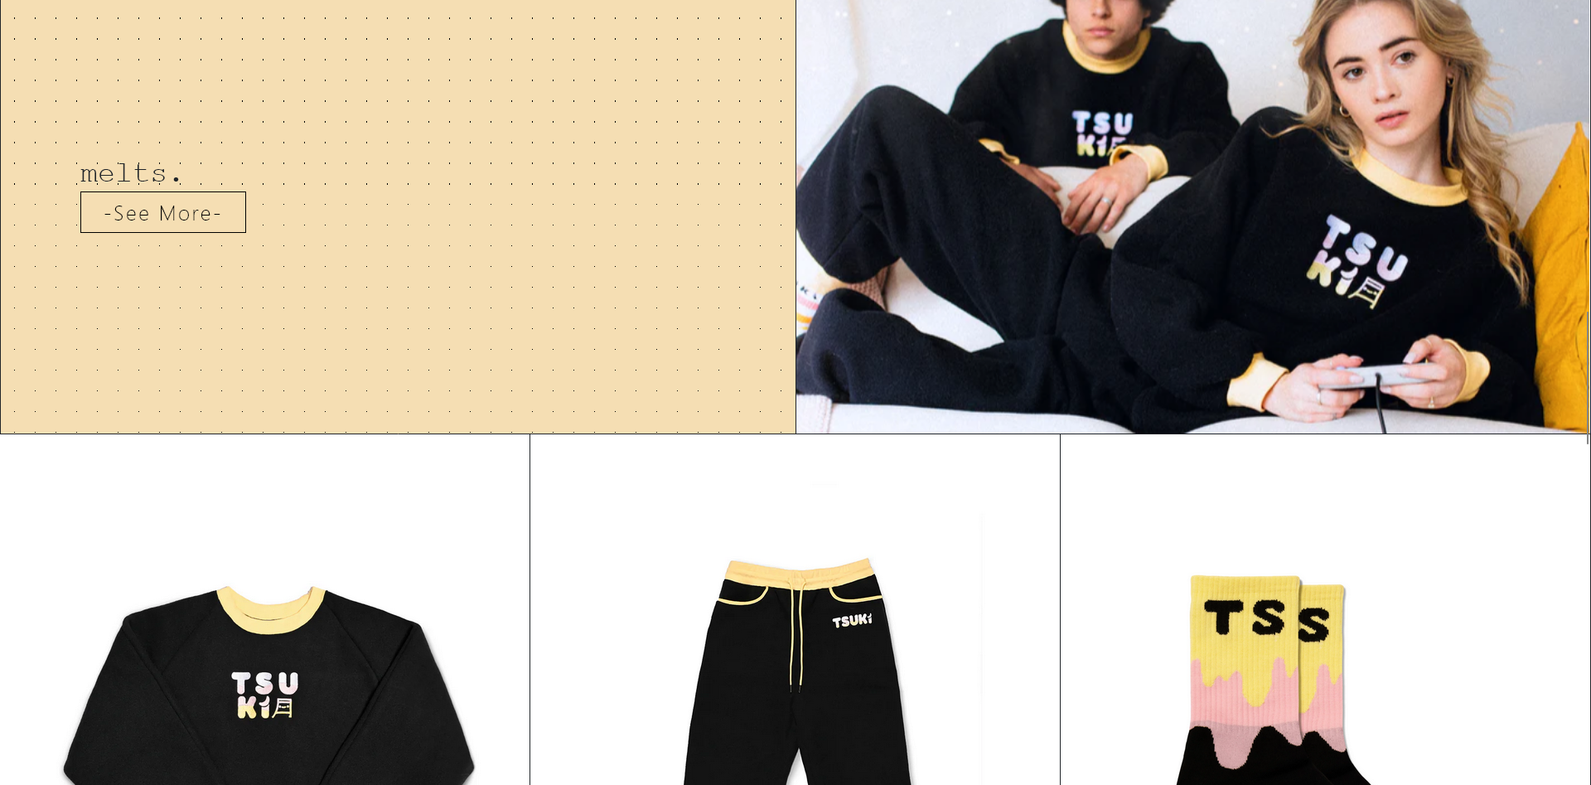
Page Design

Slide 16
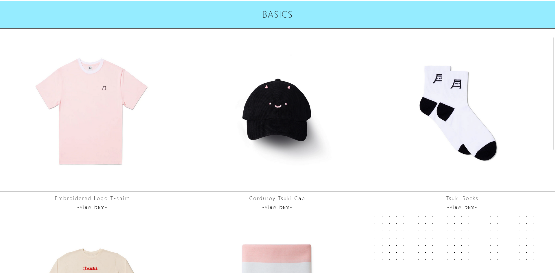
Page Design

Slide 17
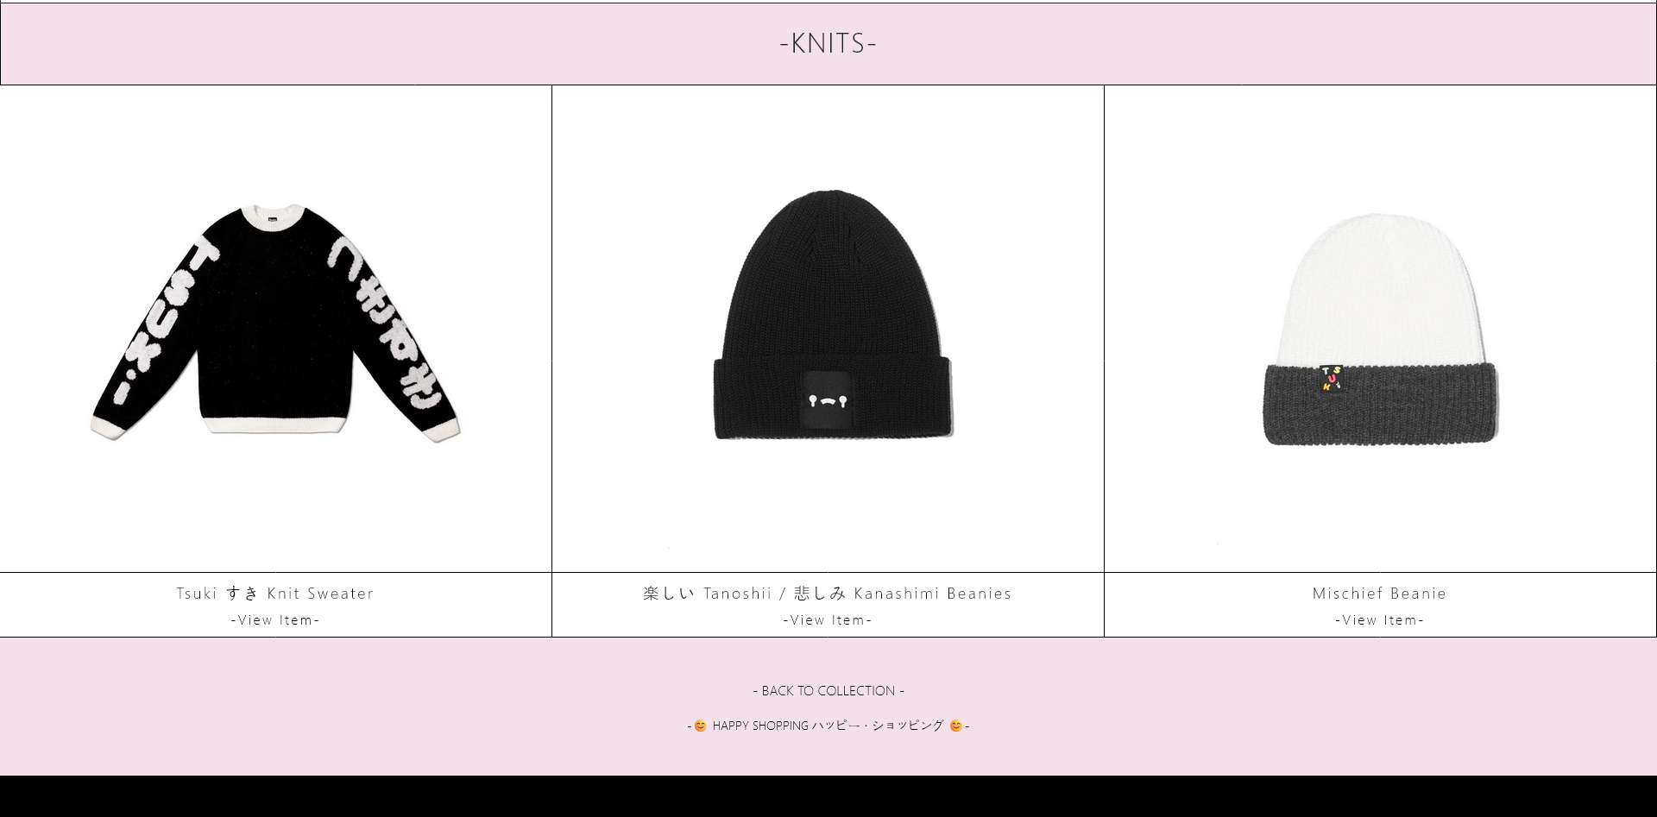
Page Design

Slide 18
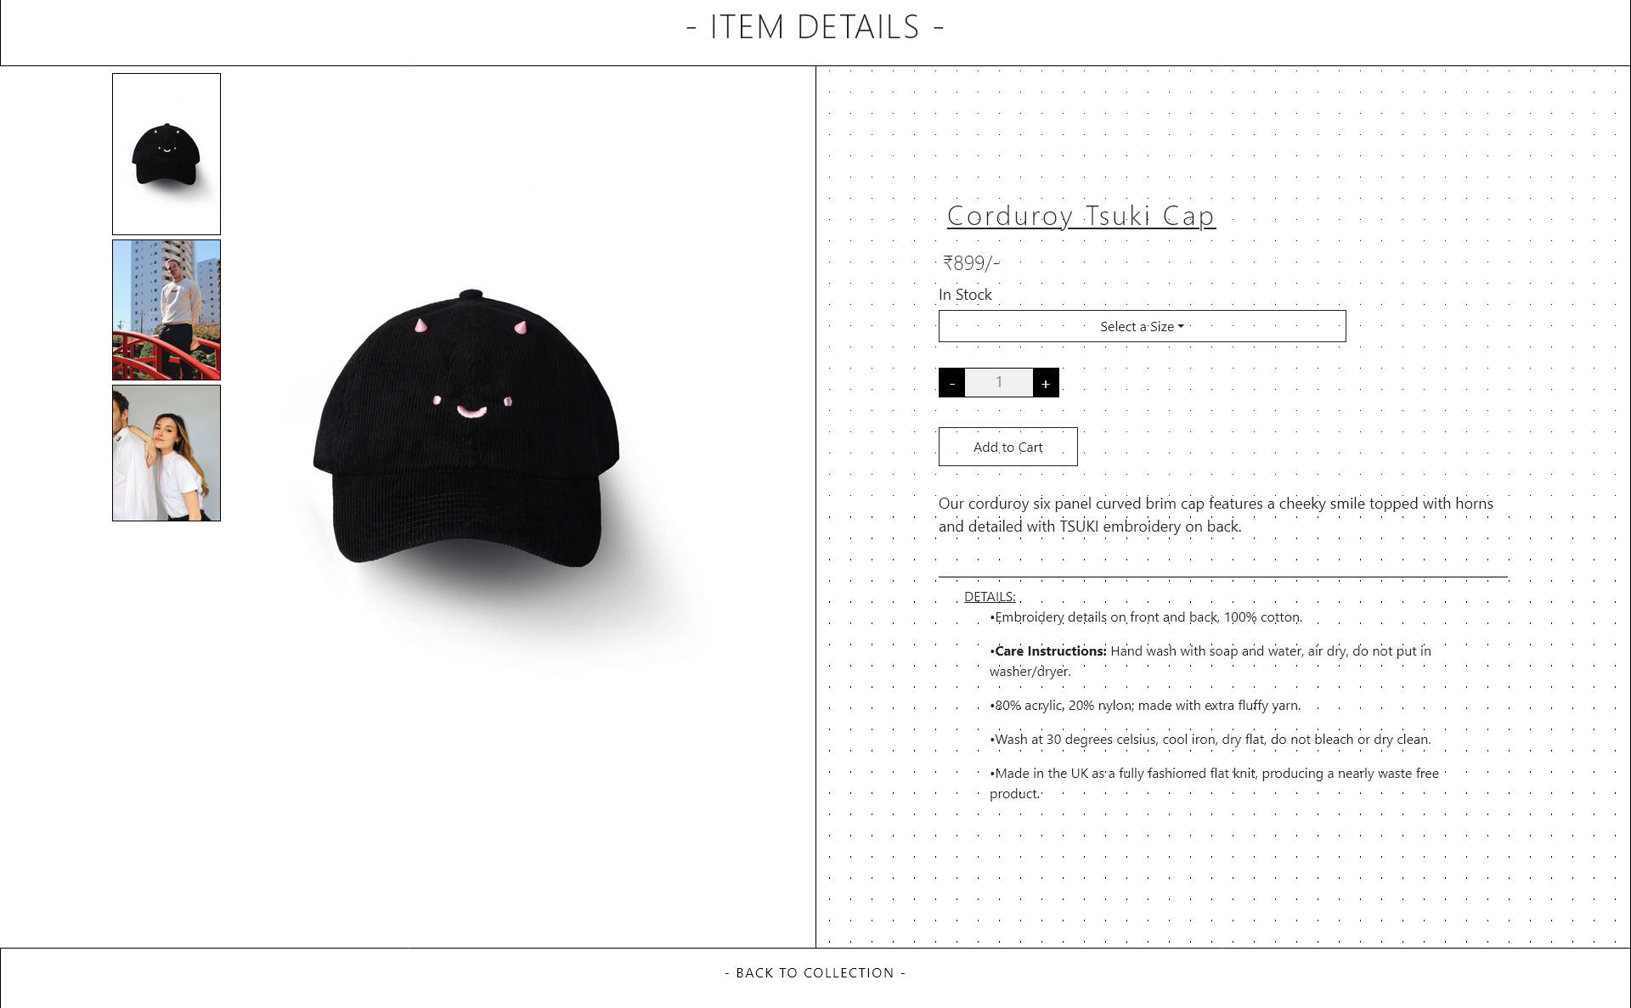
Page Design

Slide 19
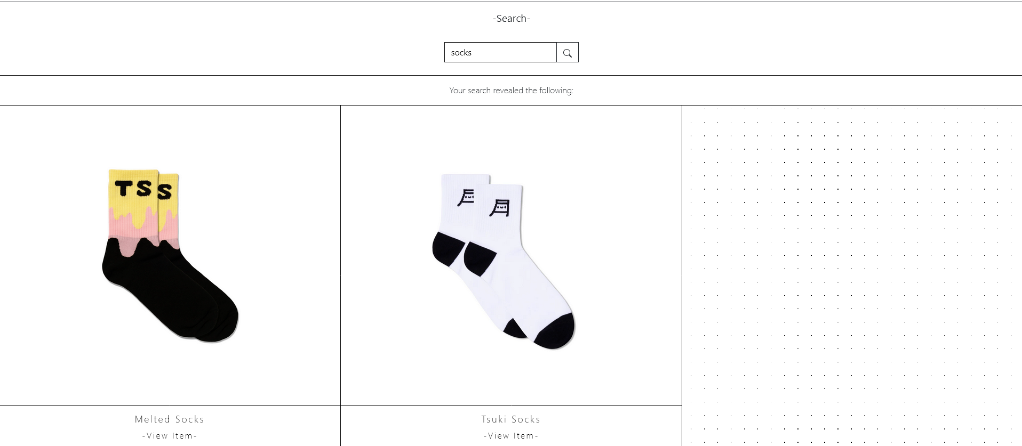
Page Design

Slide 20
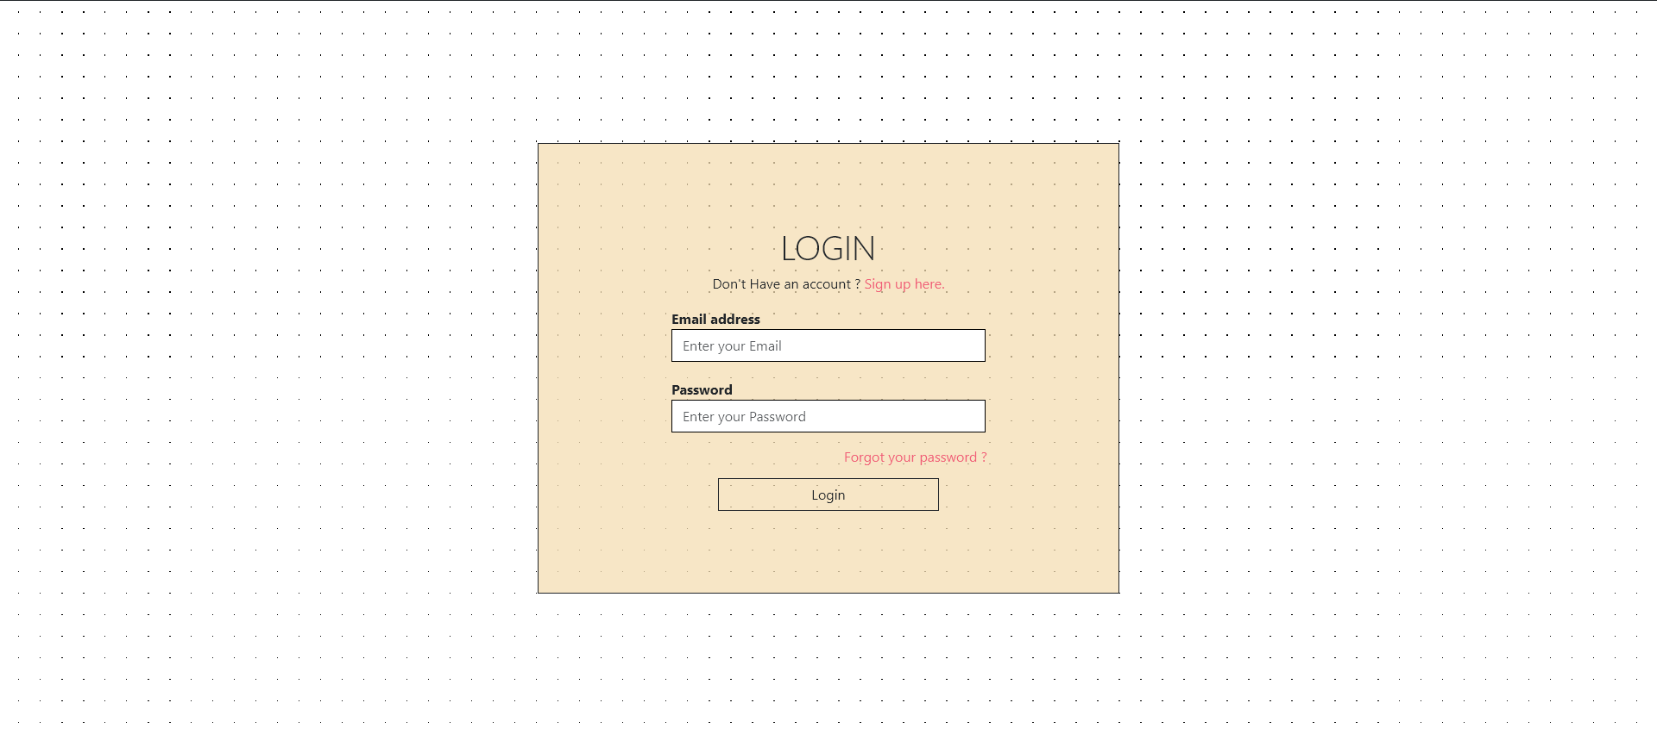
Page Design

Slide 21
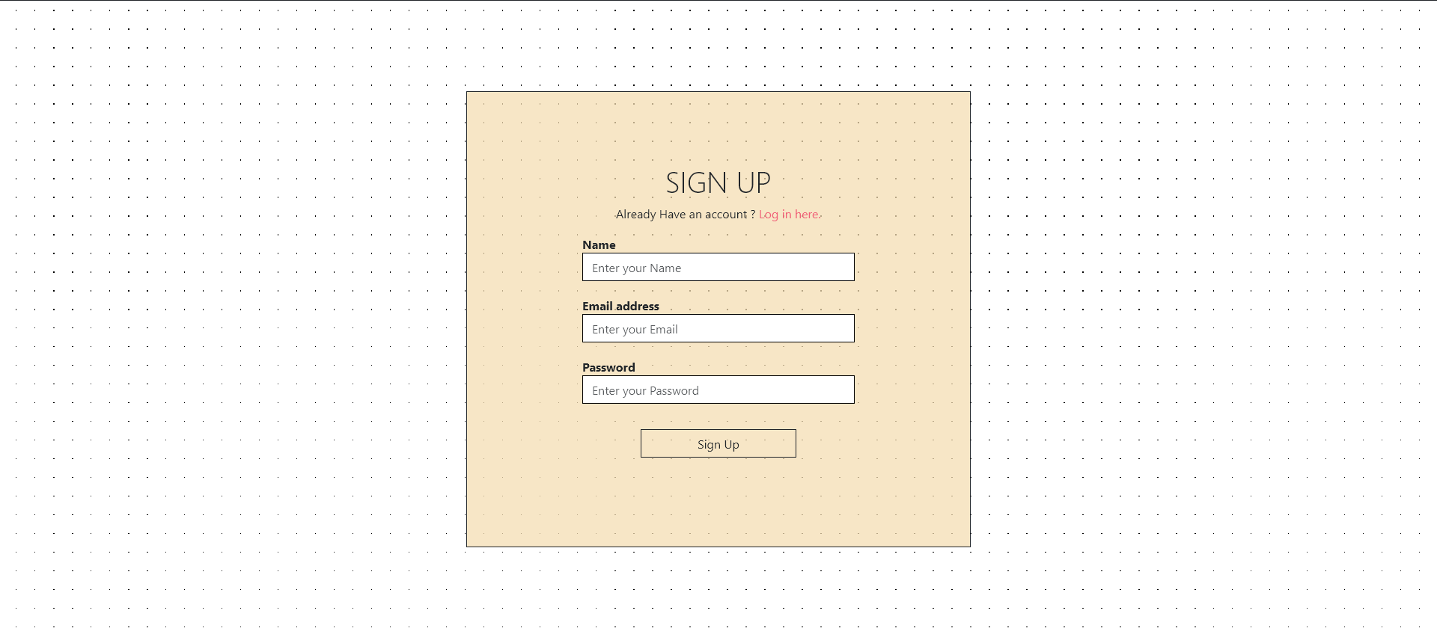

Page Design

Slide 22
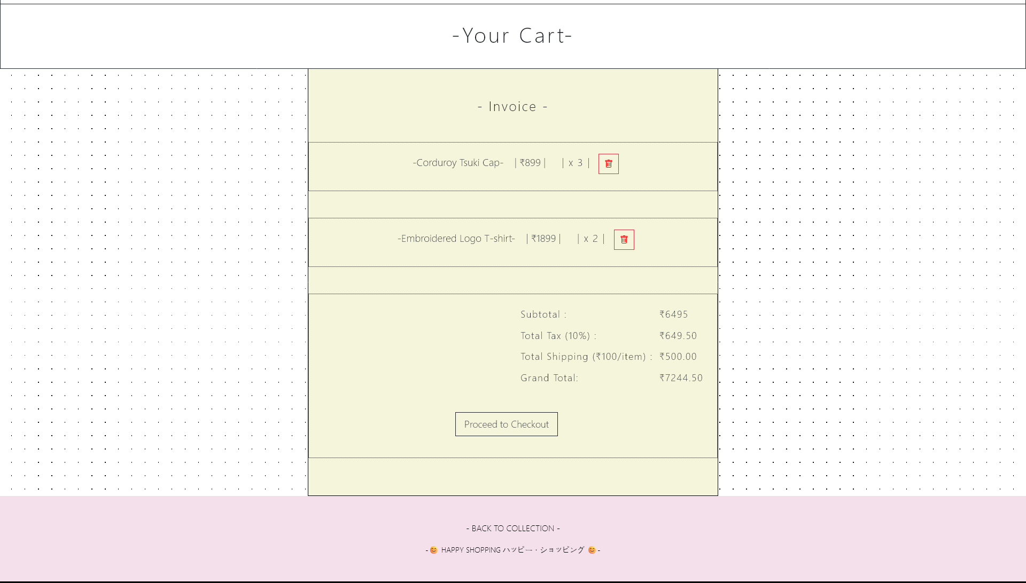
Page Design

Slide 23

System Design
Component-Based Architecture: Utilize React's component paradigm to break down the e-commerce catalog into reusable UI components (e.g., product cards, filters, search bar) for modularity and maintainability.
State Management: Implement state management solutions like React's Context API or external libraries like Redux to manage product data, user interactions, and application state across components efficiently.

Slide 24
Conclusion
In conclusion, Tsuki serves as a pivotal element within the digital retail landscape, acting as a comprehensive gateway for consumers to explore, evaluate, and purchase products or services online. Its effectiveness hinges on intuitive user experiences, accurate product information, seamless integration, robust personalization capabilities, stringent security measures, and continuous innovation.

Slide 25
References
Website Design & UX/UI:
Krug, S. (2014). Don't Make Me Think, Revisited: A Common Sense Approach to Web Usability. New Riders.
Norman, D. A. (2013). The Design of Everyday Things: Revised and Expanded Edition. Basic Books.
Nielsen, J., & Loranger, H. (2010). Prioritizing Web Usability. New Riders.
E-commerce Platform Guides: Depending on the platform you choose (like Shopify, Magento, WooCommerce, etc.), they often have comprehensive documentation and guides:
Shopify Documentation: Shopify Help Center
WooCommerce: WooCommerce Docs
Magento: Magento User Guide
SEO & Content Strategy:
Fishkin, R., & Sharp, C. (2018). Lost and Founder: A Painfully Honest Field Guide to the Startup World. Portfolio.
Handley, A. (2012). Content Rules: How to Create Killer Blogs, Podcasts, Videos, Ebooks, Webinars (and More) That Engage Customers and Ignite Your Business. Wiley.

Slide 26
Thank You

